Slide 1
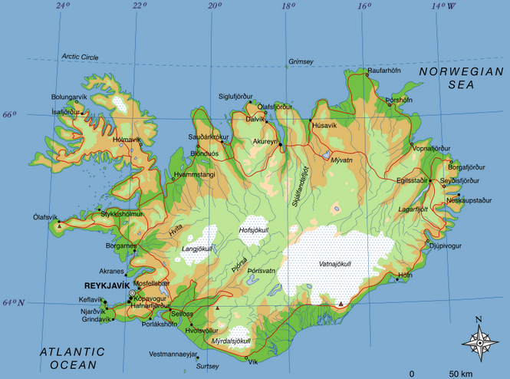
Iceland - Land of Fire and Ice

Slide 2
Iceland is located between the North Atlantic and the Arctic Ocean

Slide 3
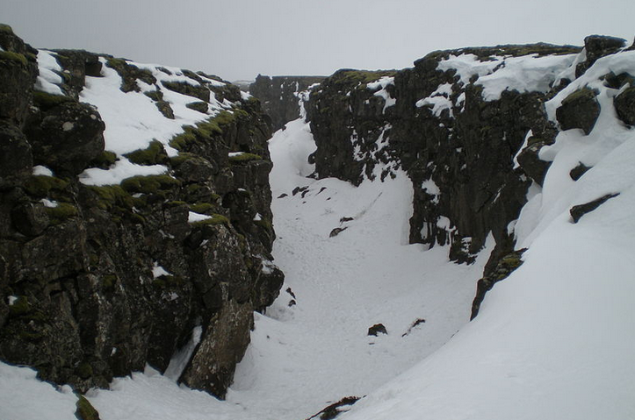
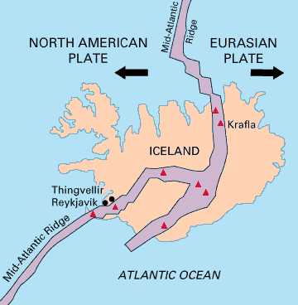
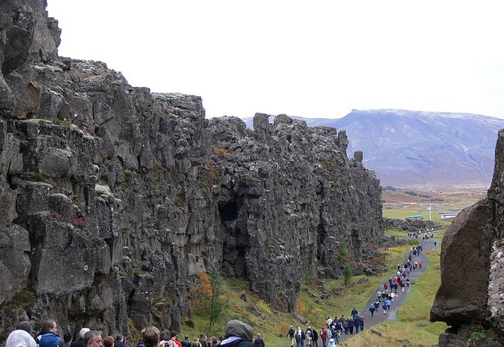
Iceland is part of the Mid-Atlantic Ridge. The ridge marks the boundary between the Eurasian and North American Plates. Iceland was created by rifting and accretion through volcanism along the ridge.

Slide 4
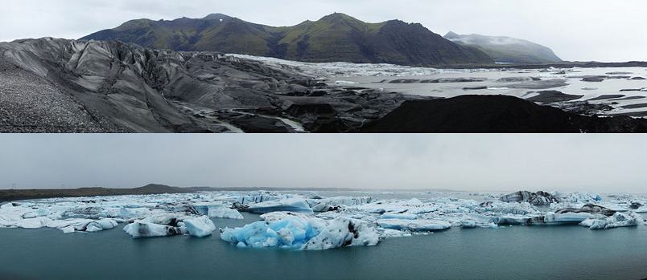
Facts about Iceland
Iceland is the Europe's second largest island after Great Britain and the world´s 18th larges.
The island is in size of 103,000 km².
62,7% of the country is tundra
Lakes and glaciers cover 14,3% of its surface
23% is vegetated.
The largest lakes are Þórisvatn (83–88 km² ) and Þingvallavatn( 82 km²⁾
Jökulsárlón is the deepest lake (248 m)

Slide 5
Facts about Iceland

Slide 6
Top 10 Crazy Facts About Iceland
https://www.youtube.com/watch?v=VEsMopVuVDk
https://www.youtube.com/watch?v=vGpjlfCfe2Y
(Oblivion)

Slide 7
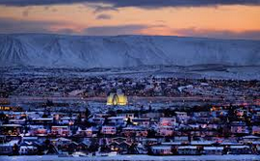
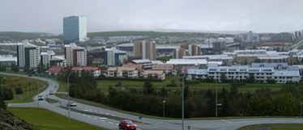
Kópavogur
Kópavogur is the second largest town of Iceland with 32308 inhabitants.
It lies immediately south of Reykjavik and is part of the Greater Reykjavik Area.

Slide 8
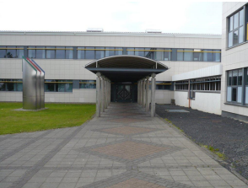
Menntaskólinn í Kópavogi
Kópavogur College School started formally in September 1973. In the school are about 100 working teachers and over 1200 students studying in three major areas of study.
Three og four-years academic program that concludes with the university matriculation exam
students study in the culinary school
Students in tourism studies

Slide 9
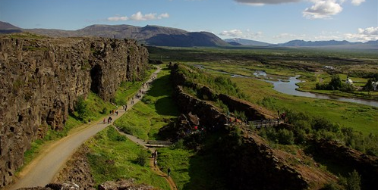
Þingvellir
At Þingvellir or "Parliament Plains" - the Alþing the major events in the history of Iceland have taken place and therefore the place is held in high esteem by all Icelanders.
Þingvellir is a natural wonder on an international scale, with the geologic history and the biosystem of Lake Þingvallavatn forming a unique entity, a magnificent showcase.
https://www.youtube.com/watch?v=B9NKhiJ6EB4

Slide 10
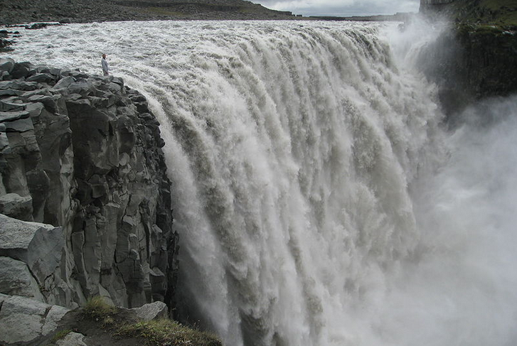
Dettifoss
Dettifoss is a Waterfall in
Northeast part of Iceland.
It is reputed to be the most powerful waterfall in Europe.
Dettifoss is situated on the Jökulsá á Fjöllum river, which flows from the Vatnajökull glacier and collects water from a large area in Northeast Iceland.
The falls are 100 meters wide and have a drop of 45 meters down to the Jökulsárgljúfur canyon. It is the largest Waterfall in Iceland in terms of volume discharge, having an average water flow of 193 m³/s.
https://www.youtube.com/watch?v=OB8cop0TLR0 (Prometheus)

Slide 11
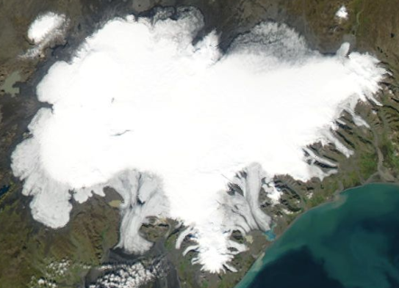
Fact about Glaciers
The glaciers cover 11.1% of the land area in Iceland. Vatnajökull is the largest in area in Europe.
Many glaciers lie above volcanoes (Grímsvötn and Bárðarbunga lie under Vatnajökull). When volcanic activity occurs under the glacier, the resulting meltwater can lead to a sudden glacial lake outburst flood, but they are most often caused by accumulation of meltwater due to geothermal activity underneath the glacier. They have occasionally triggered volcanic eruptions through the sudden release of pressure. http://www1.nams.is/jardfraedi/eldfjoll.php?id=362

Slide 12
Iceland is one of the most active volcanic regions in the world (eruptions on average every three years). About a third of the basaltic lavas erupted in recorded history have been produced by Icelandic eruptions. http://www1.nams.is/jardfraedi/eldfjoll2.php?id=350

Slide 13
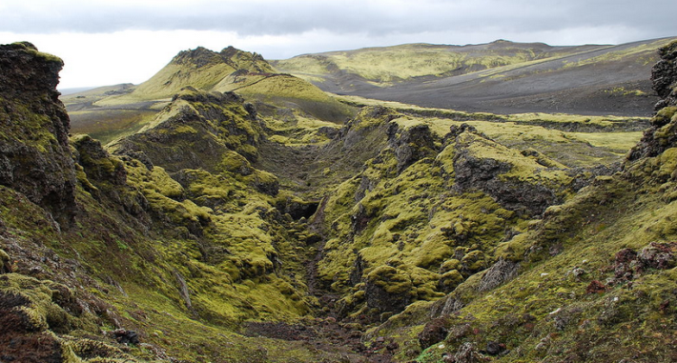
Skaftáreldar
Skaftáreldar erupted over an eight-month period between 1783 and 1784 and pouring out an estimated 14 km³ of basalt lava and clouds of poisonous hydrofluoric acid and sulfur dioxide compounds that killed over 50% of Iceland's livestock and killed 25% of the island's human population. 10 000 people died.
https://youtu.be/blDXgde1Tpg?t=7m25s

Slide 14
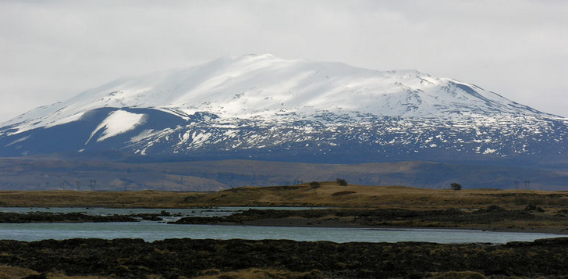
Hekla
Hekla is one of Iceland's most active volcanoes.
Over 20 eruptions have occurred in and around the volcano since 874.
During the Middle Ages, Europeans called the volcano the "Gateway to Hell".

Slide 15
Heimaey
On 21 January 1973, a series of small tremors began to occur around Heimaey. At about 01:55 on 23 January, a fissure opened up on the eastern side of the island, barely a kilometre away from the centre of the town of Heimaey. The eruption in Heimaey had started.
https://www.youtube.com/watch?v=ghl33n26d44
https://youtu.be/blDXgde1Tpg?t=26m1s

Slide 16
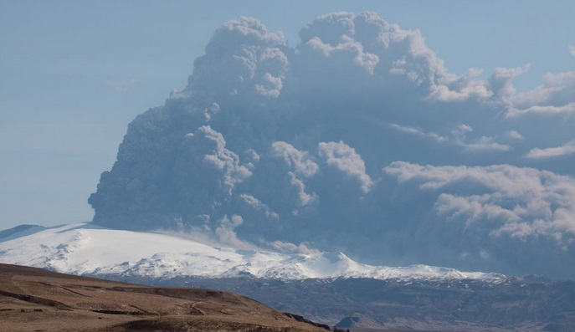
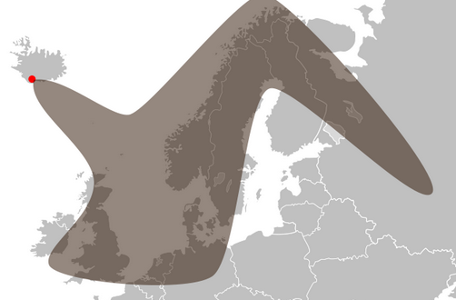
Eyjafjallajökull
It was in April in the year 2010 that the eruptions of Eyjafjallajökull started. It was a small volcanic eruptions but caused enormous disruption to air travel across western and northern Europe. The eruption was declared officially over in October 2010.
About 20 countries closed their
airspace to commercial jet traffic
and it affected about 10 million travellers.[

Slide 17
https://youtu.be/MlH7pCK4H-s?t=56s
https://www.youtube.com/watch?t=53&v=PafDMB8IBvI (Wolter Mitty)

Slide 18
Holuhraun
The lava flow is considered to be the largest since the Laki eruption of 1783. It covere 70 km² and it is more than 1 km³ in volume.
This time there were no ash in the air but pollution in the atmosphere was high all the time that erupted and traffic was forbidden on the volcano territory. Scientists were the only people that could travelled to Holuhraun.
https://www.youtube.com/watch?v=OaFmvdbff-8

Slide 19
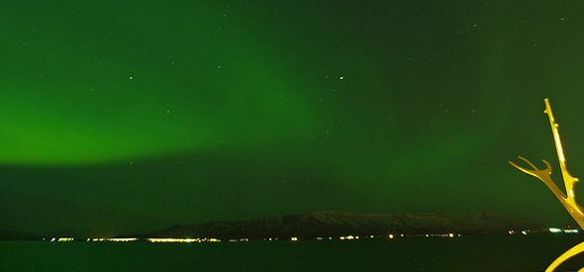
Northern lights in Iceland
The northern lights are the result of electrically charged particles from the sun colliding with gaseous particles in the Earth’s atmosphere, causing displays of bright, colourful dancing lights.
They are visible in the magnetic polar regions of the northern and southern hemispheres and they can range in coulour from white, green, pink and purple. The best season to see the northern lights in Iceland is from September to mid-April. https://www.youtube.com/watch?v=EtLBi_v02ks

Slide 20
http://bushostelreykjavik.com/last-mcdonalds-in-iceland
http://www.theguardian.com/commentisfree/2013/apr/18/iceland-anti-incest-app
http://travel-wonders.com/2009/09/28/the-icelandic-phonebook-surprise/
http://www.wizzed.com/13-crazy-and-weird-facts-about-iceland/2/

